Slide 1





CARTIFY’S DATA-DRIVEN STRATEGY
GROUP 37​ - 5594410, 5663426, 5580065, 5666984, 5610758, 5589099​

Slide 2


Agenda
Business Context
Key Business Goals
Database Design
Key Business Insights
Recommendations for Cartify
Key Business Challenges
Conclusion and Business Impact
1

Slide 3



Business Context
BUSINESS CHALLENGES
DATA LIMITATIONS
SOLUTION NEEDED
Cartify struggles with customer retention, inefficient marketing spend, and a lack of data insights, preventing optimisation.
The absence of data-driven insights hinders tracking customer behaviour, campaign effectiveness, and sales trends, leading to poor decisions and wasted spend.
A structured data product is essential to capture and analyze key insights, enabling smarter decisions, optimised marketing, and revenue growth.
2

Slide 4
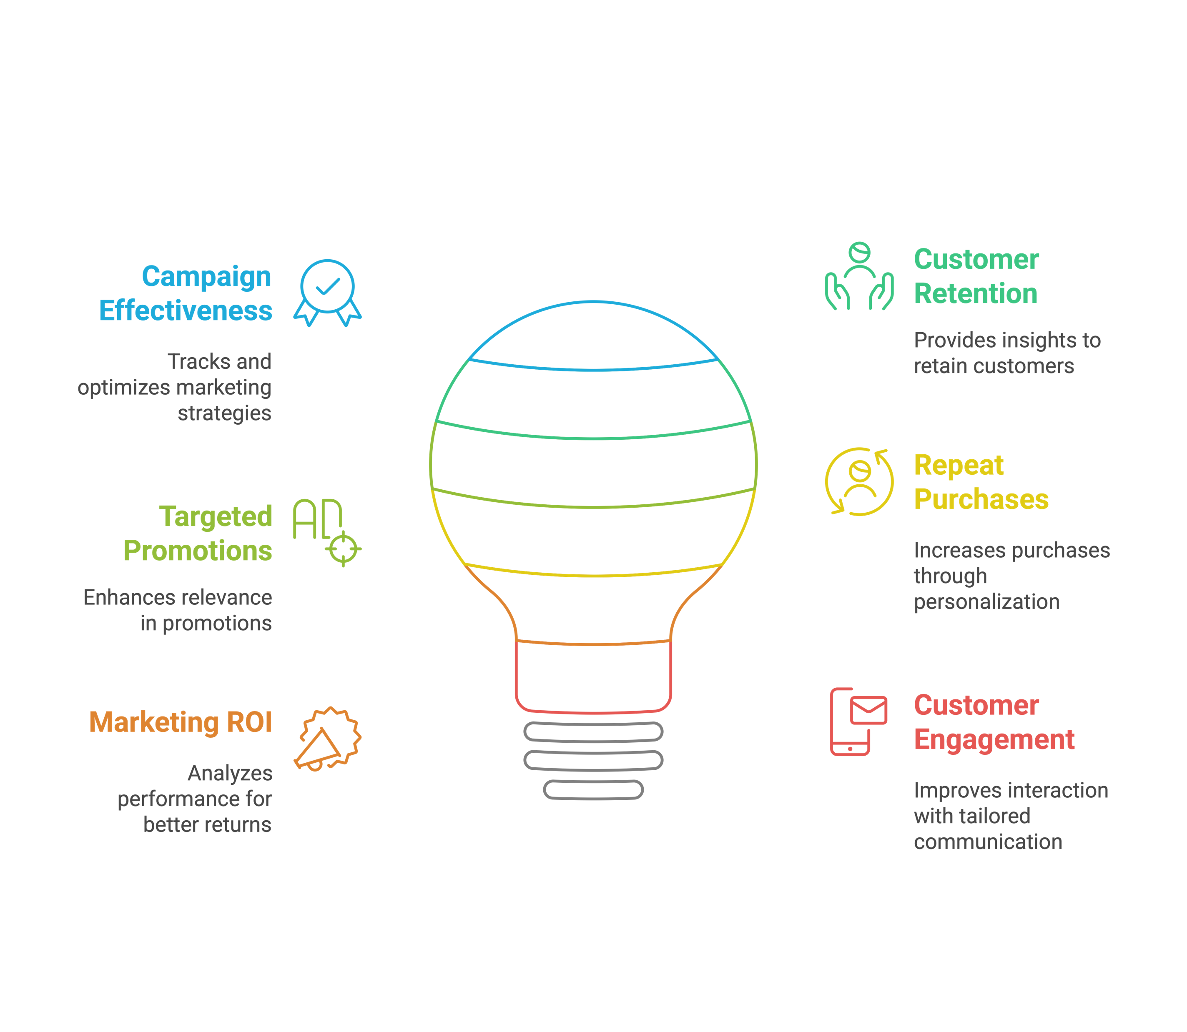








Key Business Goals
Campaign
Effectiveness
Customer
Retention
Track customer
insights to
retain customers.
Track and
optimise marketing
strategies.
Repeat
Purchases
Targeted
Promotions
Increase repeat purchases
through
personalised offers.
Enhance targeted promotions and pricing decisions to increase relevance.
Marketing
ROI
Customer
Engagement
Analyse
campaign performances
for better returns.
Improve
customer engagement
through tailored
communication.
3

Slide 5






Database Design
Customers
Track customer information and behaviour.
Marketing Campaigns
Monitor campaign performance.
Discounts
Track discount effectiveness and impact on Profit & Loss.
Products
Handle product data and stock.
Orders
Track order information and order processing.
4

Slide 6
KEY
BUSINESS
INSIGHTS
5

Slide 7
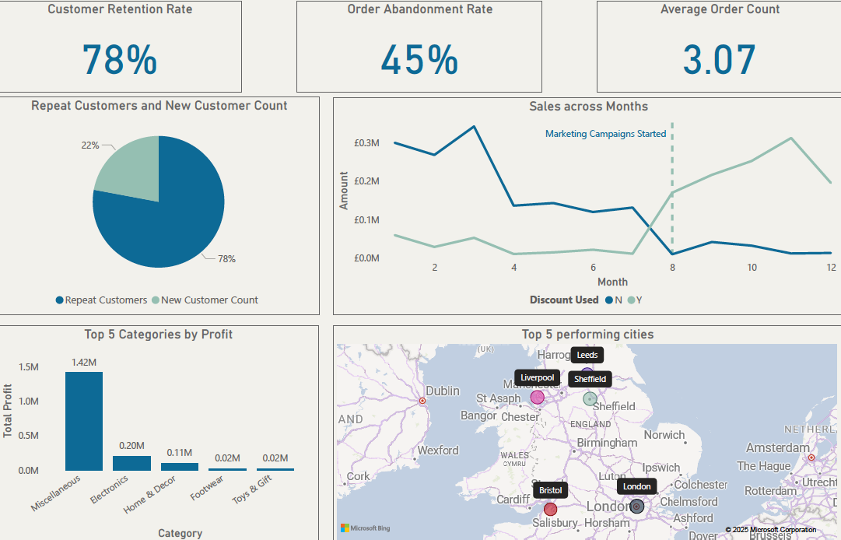
Customer & Sales Analysis
6

Slide 8
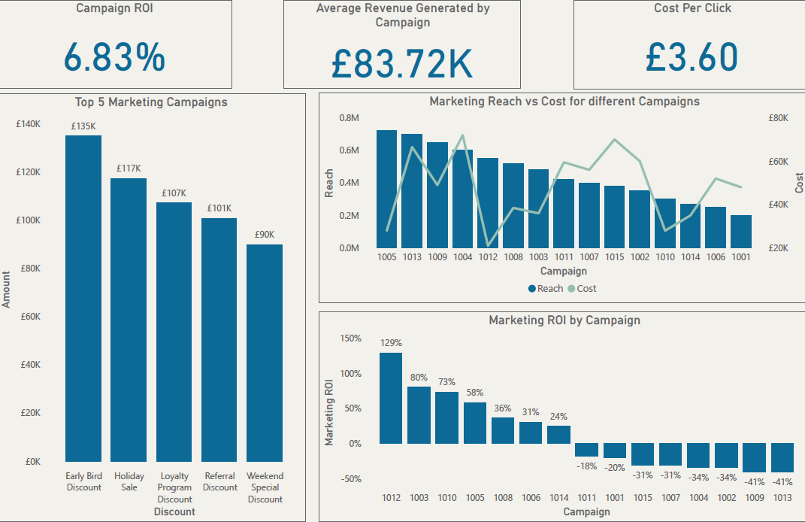
Marketing Performance
7

Slide 9

Recommendations for Cartify
Boost Customer Retention
Optimise Pricing & Inventory
Implement targeted loyalty programs and personalised marketing to increase repeat purchases and reduce churn.​
Leverage performance insights to adjust pricing strategies & ensure optimal stock levels for top-selling products.​
Maximise Marketing ROI
Maximise Campaign Effectiveness
Redirect budget to high-performing campaigns and channels, eliminating wasteful spend for better efficiency.​
Focus on high-value categories and leverage data-driven discounts to significantly increase conversions and sales.​
8

Slide 10




Key Business Challenges
Data Privacy & Compliance
Data Integration Issues
Navigating complex marketing laws and ensuring compliance with data privacy regulations.
Merging data from various sources with different formats and structures created significant complexities.
Scaling for Future Growth
Lack of Real-Time Insights
Ensuring that the current data system can process and analyse unstructured, diverse data from social media and the internet without compromising performance or accuracy.
Difficulty in processing and analysing data in real-time, limiting the ability to quickly adjust marketing strategies.
9

Slide 11
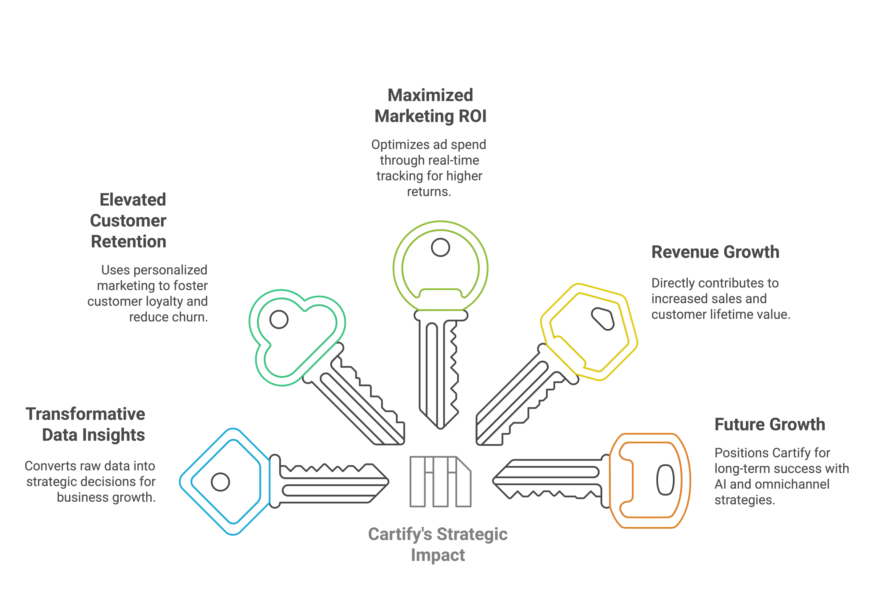

Conclusion & Business Impact
Maximised Marketing ROI
Optimise ad spend through real-time tracking for higher returns.
Enhance Customer Retention
Revenue Growth
Use personalised marketing to foster customer loyalty and reduce churn.
Personalised campaigns and refined product strategies directly contribute to increased sales and customer lifetime value.
Transformative Data Insights
Future Growth
AI-powered personalisation and omnichannel expansion position Cartify for long-term success.​
Convert raw data into strategic decisions for business growth.
Orders
10

Slide 12

Thank-you !
11

